Slide 1

Fundamentals of Information System Security SEC285: Final Project By: Kassandra Moreno

Slide 2
Introduction
Welcome to my academic introduction to Information Security. This presentation will demonstrate my ability to understand and carry out the following topics:
Asymmetric Key Encryption
Stateful Firewall
Bring Your Own Device (BYOD) Security Policy
Multifactor Authentication (MFA)
Vulnerability Assessment

Slide 3
Asymmetric Key Encryption

Slide 4
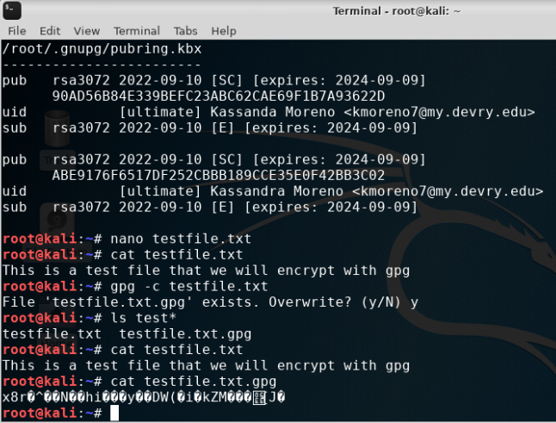
Encryption
Content of plaintext file and encrypted file

Slide 5
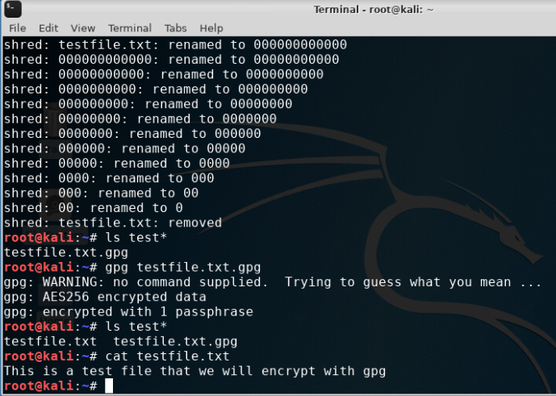
File Decryption
The encrypted file being listed
The decrypting process
Both the encrypted file and the original plaintext file listed

Slide 6
Stateful Firewall

Slide 7
Food for Thought
What effect does the sudo iptables --policy INPUT DROP command have on the access to computing resources?
Answer: The sudo iptables --policy INPUT DROP command drops any IP inputs that do not fall under the created policy rules.
Reference: DeVry SEC 285 - Module 3: Stateful Firewall | Infosec Learning

Slide 8
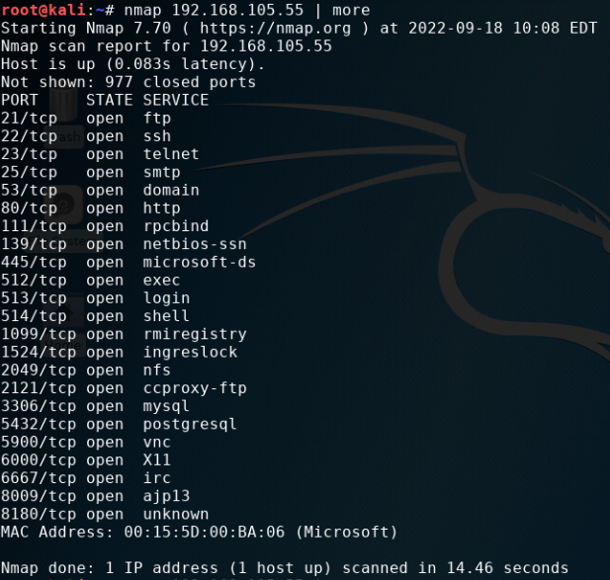
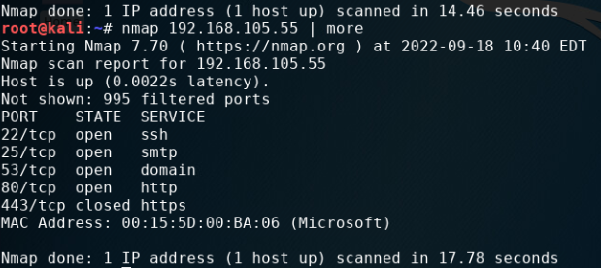
NMAP Scan
After IPtable rules
Before new IPtable rules

Slide 9
Bring Your Own Device (BYOD) Security Policy

Slide 10
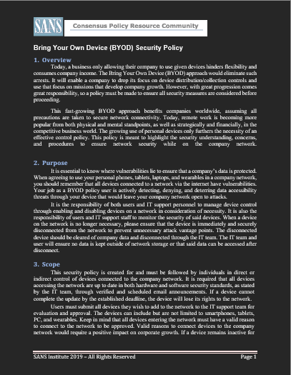
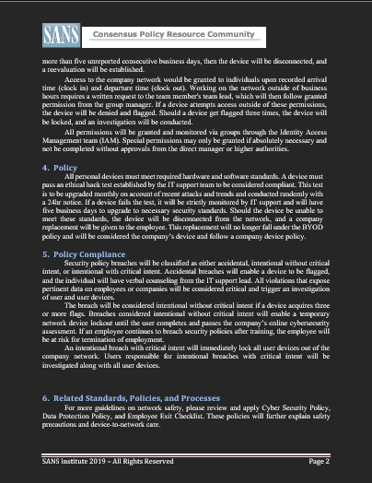
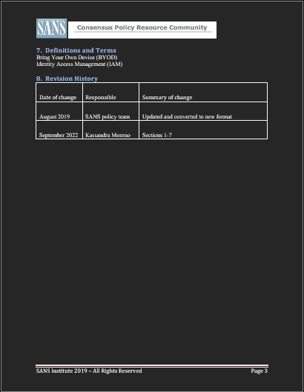
BYOD Security Policy

Slide 11
Multifactor Authentication (MFA)

Slide 12
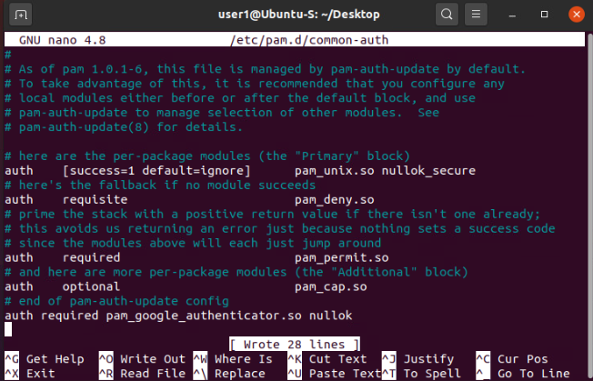
Common-auth Configuration File
Indicates the use of the Google Authenticator module.

Slide 13
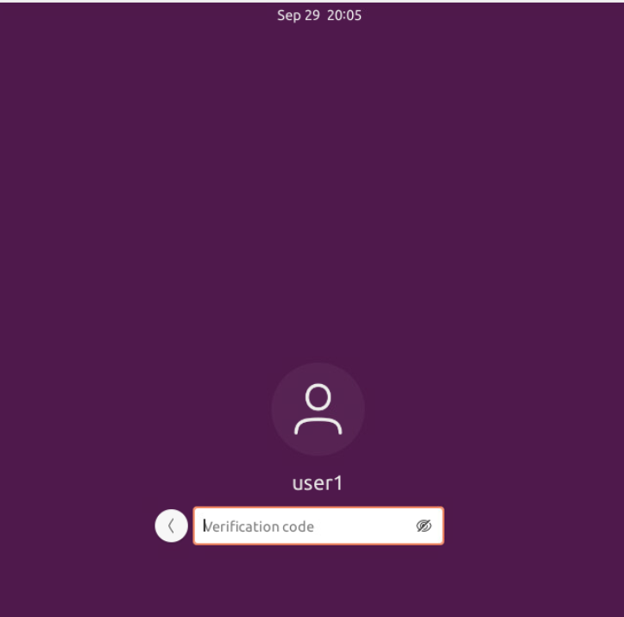
MFA Login Screen
Request for generated Google Authentication code

Slide 14
Vulnerability Assessment

Slide 15
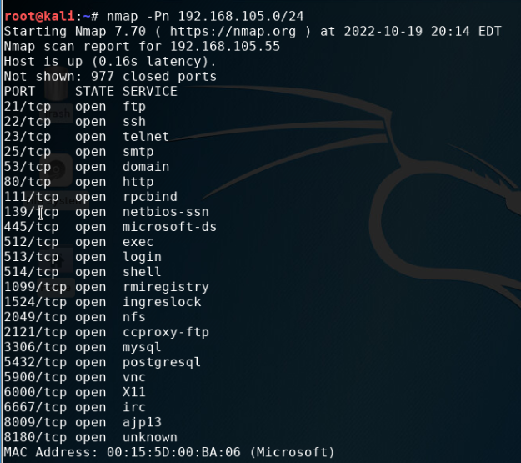
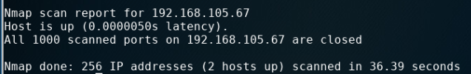
Nmap Scan
Scan of both Kali and Linux Server Virtual Machines

Slide 16
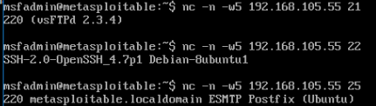
NetCat Scan
Scan of both Kali and Linux Server Virtual Machines

Slide 17
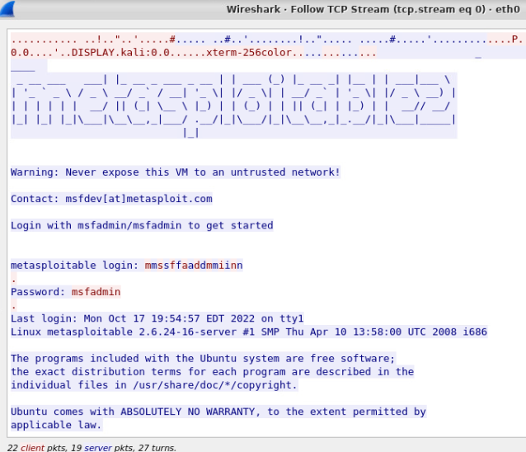
Wireshark
TCP Steam window showing the Telnet username and password

Slide 18
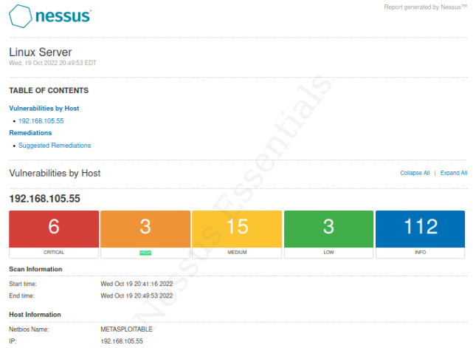
Nessus
Nessus vulnerability scan reporting network vulnerability in categories.

Slide 19
Challenges
Due to previous understandings of information security, many of the commands and concepts were not entirely foreign to me through this course. However, I still found challenges in some of the new information given. I would say my biggest challenge was operating in Wireshark. Wireshark analyzes the protocols in a network with a very powerful application to capture packets in a network. This was my first encounter with Wireshark, so I had my challenges in navigating and exploring the platform. These challenges where overcome through course instruction and YouTube.

Slide 20
Career Skills
When entering a career field in technology, understanding and capability to carry out data protection is a highly in-demand skill. This course has given me fundamental understandings of data and device security, along with steps that can and should, be taken to further fortify said security.

Slide 21
Conclusion
In this presentation, I have displayed my understanding and capability to carry out asymmetric key encryptions, stateful firewalls, BYOD security policies, MFA initializing, and vulnerability assessments.

